Slide 1
Principal Components Analysis
(PCA) Neural Networks - Part Two
Part Two
http://www.machineilab.org
64 pages

Slide 2

Application: Image Compression
512 pixels
512 pixels
The original picture is a 512x512 pixel one.

Slide 3
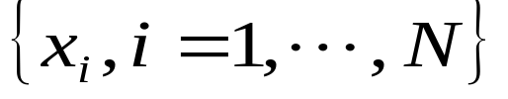

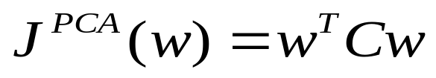

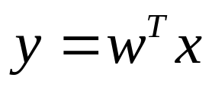
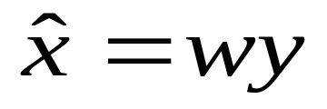
Application: Image Compression
1、preprocess the data.
2、Find the principal component (PCA Neural Networks algorithm).
3、Compress the image.
4、Reconstruct the image.
64 pages

Slide 4
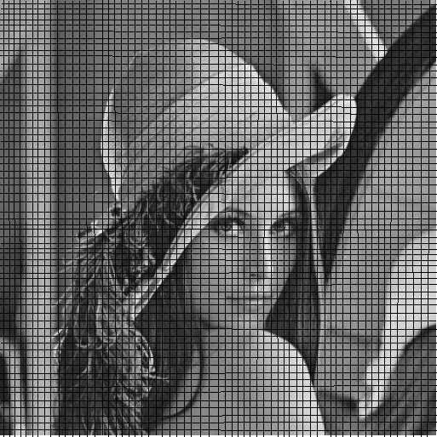
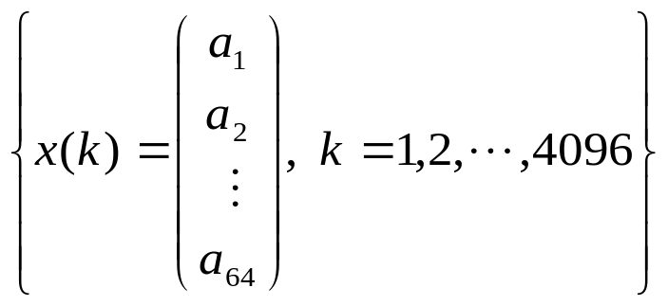
Application : Image Compression
The image is decomposed into
64x64 blocks that do not overlap
each other.
Each block contains 8x8 pixels, which is digitized into a 64 dimension column vector. The original picture amounts to 4096 stochastic vectors.

Slide 5



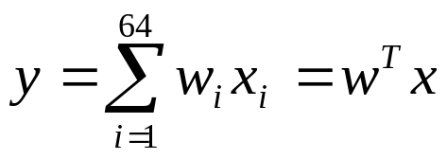



Application : Image Compression
The weight vector w is initialized randomly. Input data x are randomly selected to train network until w converges to a fixed vector.

Slide 6
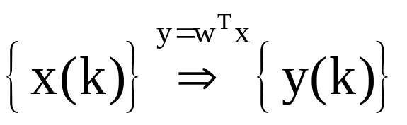

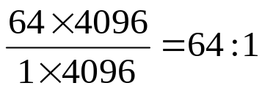
Application : Image Compression
After convergence of the weight vector, the principal component is extracted as the weight vector w.
64-dimensional
vector
1-dimensional
vector
Image Code
Compressed rate:

Slide 7
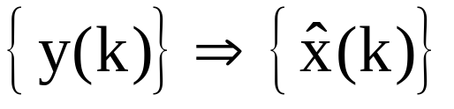
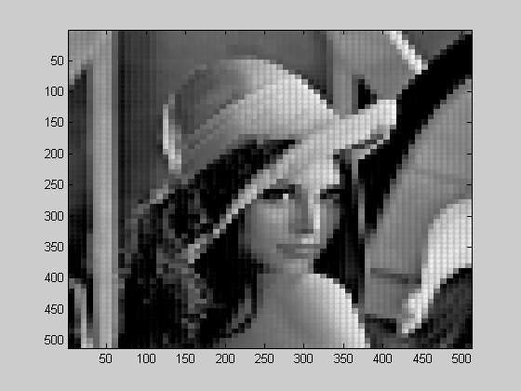

Application : Image Compression
Reconstruction
1-dimensional
vector
Image Code
64-dimensional
vector

Slide 8

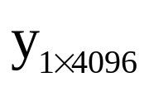
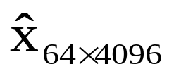


PCA Solution
Compression
Reconstruction
PCA neural networks
extract principal component w
64 pages

Slide 9
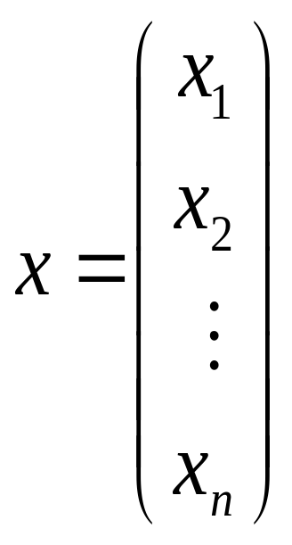

PCA Neural Networks
NN
One dimensional data
High dimensional data
64 pages

Slide 10
Extracting More Principal Components
Extracting More Principal
Components by Using
Neural Networks
64 pages

Slide 11
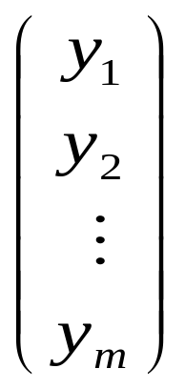

Review of PCA Concept
NN
High dimensional data
64 pages

Slide 12
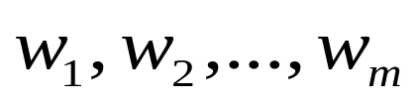
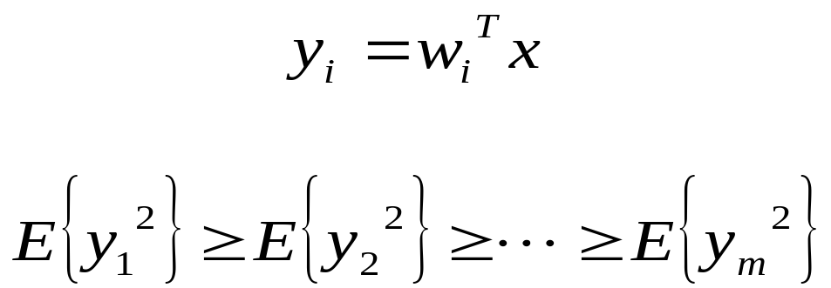
Review of PCA Concept
Search m orthogonal directions
so that the data set along these directions has largest variations.
64 pages

Slide 13
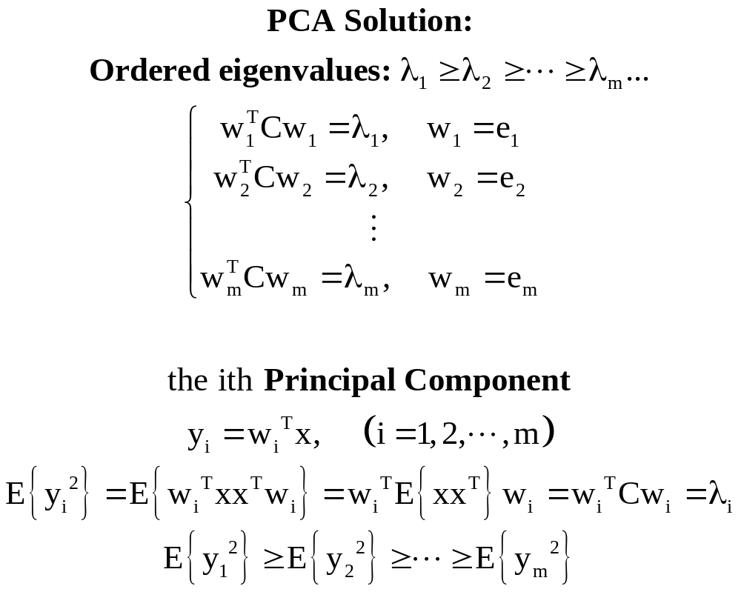
PCA Solution
64 pages

Slide 14

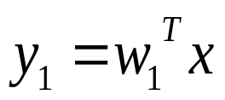

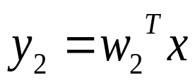
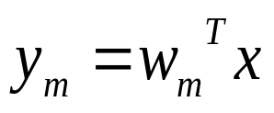


PCA Neural Networks
64 pages

Slide 15


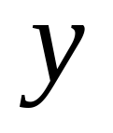


PCA Solution
compression
recover
m-dimension(m<n)
n-dimension
n-dimension
64 pages

Slide 16
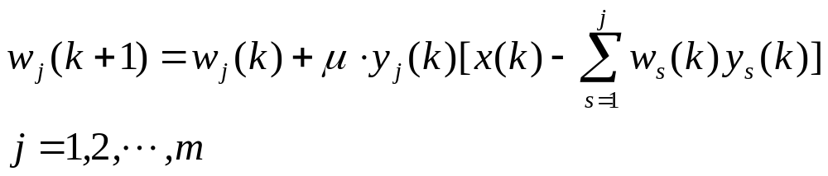
GHA Learning Algorithm
In 1989, Sanger proposed the Generalized Hebbian Algorithm (GHA)
64 pages

Slide 17


The Case J=2
(Oja Algorithm)
64 pages

Slide 18
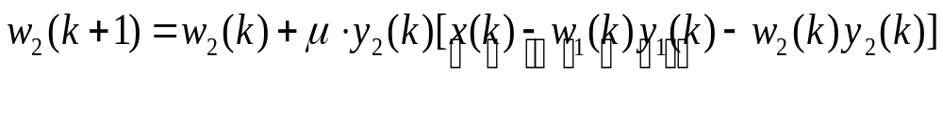

The Case J=2
64 pages

Slide 19
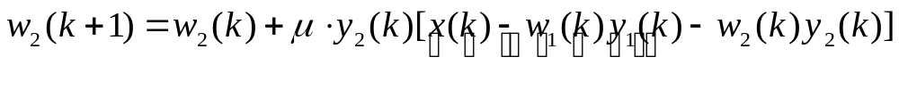
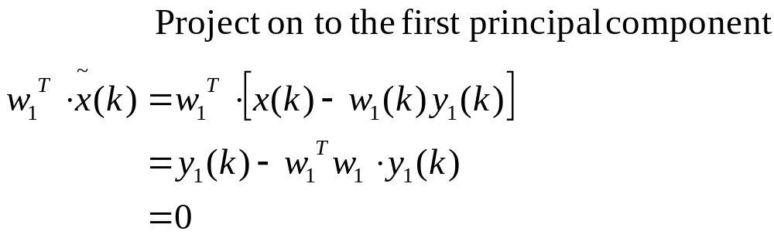
The Case J=2
Project on to the first principal component:
64 pages

Slide 20
Application: Image Compression
64 pages

Slide 21
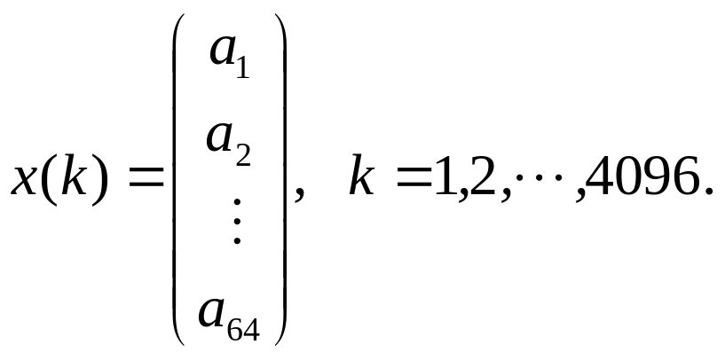
Application: Image Compression
64 pages

Slide 22




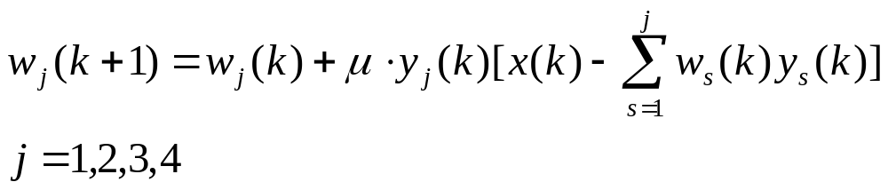
GHA Learning Algorithm
64 pages

Slide 23


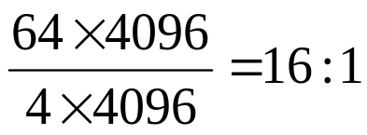
Application: Image Compression
compression
recover
4-dimension
64-dimension
64-dimension
Compressed rate
64 pages

Slide 24
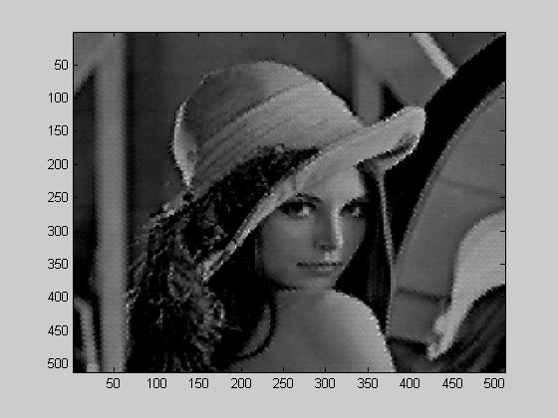
The Reconstructed Result
64 pages

Slide 25
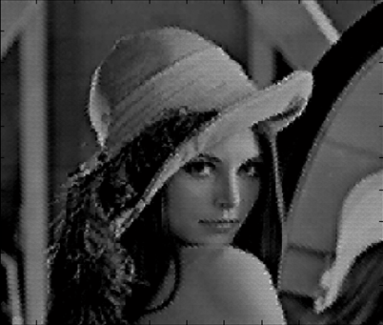
Comparison
Original
Reconstructed
64 pages

